Slide 1
Portfolio Optimization
Winter 2019 - MSDS SEC58 - Final Project
SPS - Northwestern University - Instructor: Dr. Carrie Dugan
By: Aamer Khan, Annie Reber, Bo Hong
Notes:
Hello Everyone,
We are Group 4
My name is Aamer Khan and I will be presenting alongside my team members Bo Hong and Annie Reber. (Reeber )
Our Final Project is on the Topic of Portfolio Optimization

Slide 2
Introduction
Our final project will explore the idea of Portfolio Optimization (PO)
What is PO?
Two Major Goals of PO
Minimize Risk
Maximize Reward
Notes:
For our project we wanted to tackle the real world scenario of Portfolio Optimization.
So what exactly is PO?
Portfolio optimization is the process of selecting the best portfolio (asset distribution), out of the set of all portfolios being considered according to some objective. The objective typically maximizes factors such as expected return, and minimizes costs like financial risk.

Slide 3
Theory
Notes:
So before we go any further lets discuss some theory behind Portfolio Optimization

Slide 4
A good portfolio is more than a long list of good stocks and bonds. It is a balanced whole, providing the investor with protections and opportunities with respect to a wide range of contingencies.
– Harry Markowitz
Notes:
We will begin with a quote

Slide 5
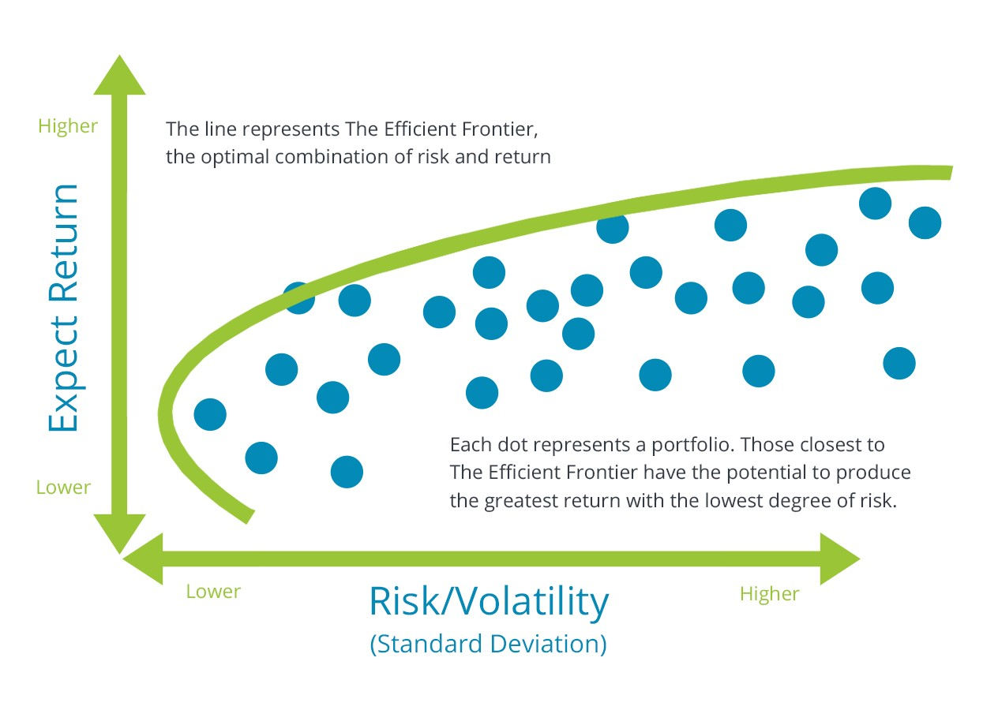
Theory Continued…
Modern Portfolio Theory (MPT)
2 Major Points
1. High Risk – High Return
2. Low Risk – Low Return
Mean Variance Optimization (MVO)
Balance Mean & Variance
Efficient Frontier
Sharpe Ratio
Notes:
Harry Markowitz is the 1990 Nobel Memorial Prize winner in Economic in case you were wondering.
He is the creator of MPT which is an integral part in understanding Portfolio Optimization
Well what is MPT?
Modern Portfolio Theory (MPT)
It is an investment theory developed by Harry Markowitz
Modern Portfolio Theory - It revolves around a concept called ‘risk-return trade-off’.
Higher risk is associated with greater probability of higher return and lower risk with a greater probability of smaller return.
Another factor comes in to play in MPT is “diversification”.
Modern portfolio theory says that it is not enough to look at the expected risk and return of one particular stock.
By investing in more than one stock, an investor can reap the benefits of diversification — The biggest among them is a reduction in the riskiness of a portfolio.
Secondly we need to discuss Mean Variance Optimization MVO. Mean Variance Optimization (MVO) is based on expected utility theory where mean and variance are balanced to approximate expected return. These expected returns can be used to build an efficient frontier where investors can choose a portfolio on this mean-variance efficient frontier based on their risk level.
The goal of portfolio optimization is to determine the weights of the stocks with minimum portfolio risk at a specific rate of return.
Lastly we need to know about one last thing called Shape’s Ratio. (SR) and has been used to evaluate the return of an investment to its risk.
In our analysis, we carried out portfolio optimization utilizing a the mean-variance optimization model with efficient frontier to select the best portfolio. Since we are beginner investors and want to start with a basis of understanding portfolio optimization, the foundations was the best place to start.
Now on to Our Problem which I will hand off to my teammate Bo ….

Slide 6
Our Problem
So what does it mean if we want to optimize our own portfolio of assets?
Our stocks:
Bank of America
Nike
Nvidia
Starbucks
Notes:
What we are saying is how much of each stock should we have in order to maximize return while minimizing risk.
Why did we choose the following stocks? Well we wanted to exercise the benefits of diversification. Each of our assets is from a different sector of our economy. From Finance to Retail and Tech to Food and Beverage. In other words we didn’t want to put all of our eggs into one basket.

Slide 7

Assumptions & Objective
Assumptions:
Investors are Risk Averse
Diversification
Objective:
Use Python to find optimal portfolios
Apply mean-variance portfolio optimization
Notes:
Assumptions:
Modern portfolio theory assumes that investors are risk-averse, meaning that given two portfolios that offer the same expected return, investors will prefer the less risky one.
Another factor comes in to play in MPT is “diversification”.
Modern portfolio theory says that it is not enough to look at the expected risk and return of one particular stock.
By investing in more than one stock, an investor can reap the benefits of diversification — The biggest among them is a reduction in the riskiness of a portfolio.
By investing in more than one stock, an investor can reap the benefits of diversification — chief among them, a reduction in the riskiness of the portfolio.
Objective:
Our objective is to apply mean-variance optimization in python to find optimal portfolios.
We look at past historical data of the four stocks and use the mean-variance model to find optimal portfolios.
By doing so, we are also testing if diversification (by blending companies from different industries and what we think have low correlations) is achievable. Can we lower the risk level of our portfolio than just carrying one or two stocks?

Slide 8
Approach
Data: Yahoo Finance
Methodologies applied
Mean-variance
Monte Carlo
Efficient frontier
Find optimal portfolios
Maximum Sharpe Ratio
Lowest volatility
Notes:
For data, we pulled historical stock information from Yahoo Finance. The Python library Pandas allows users to easily pull stocks quotes.
Primary methodology applied is the mean-variance optimization to structure the way we want to calculate the returns and volatility. We gathered the weighted average of the mean returns and the sum of the terms in the covariance matrix of the stocks. We used Python’s NumPy package to calculate the mean-variance of returns for individual assets and portfolios.
We then used Monte Carlo to simulate many randomly generated portfolios with varying weight of the four stocks (Bank of America, Nike, Nvidia, and Starbucks) to observe the outcomes.
We then plotted the returns against volatility to create an efficient frontier that shows the maximum return for various level of risks.

Slide 9
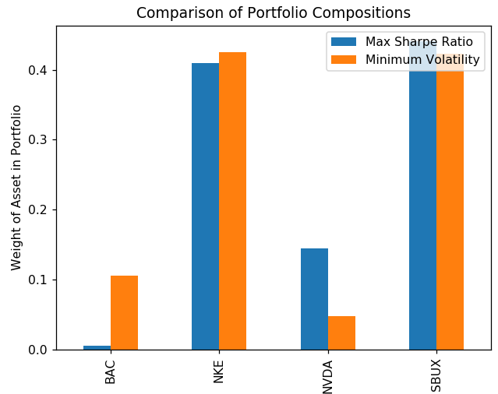
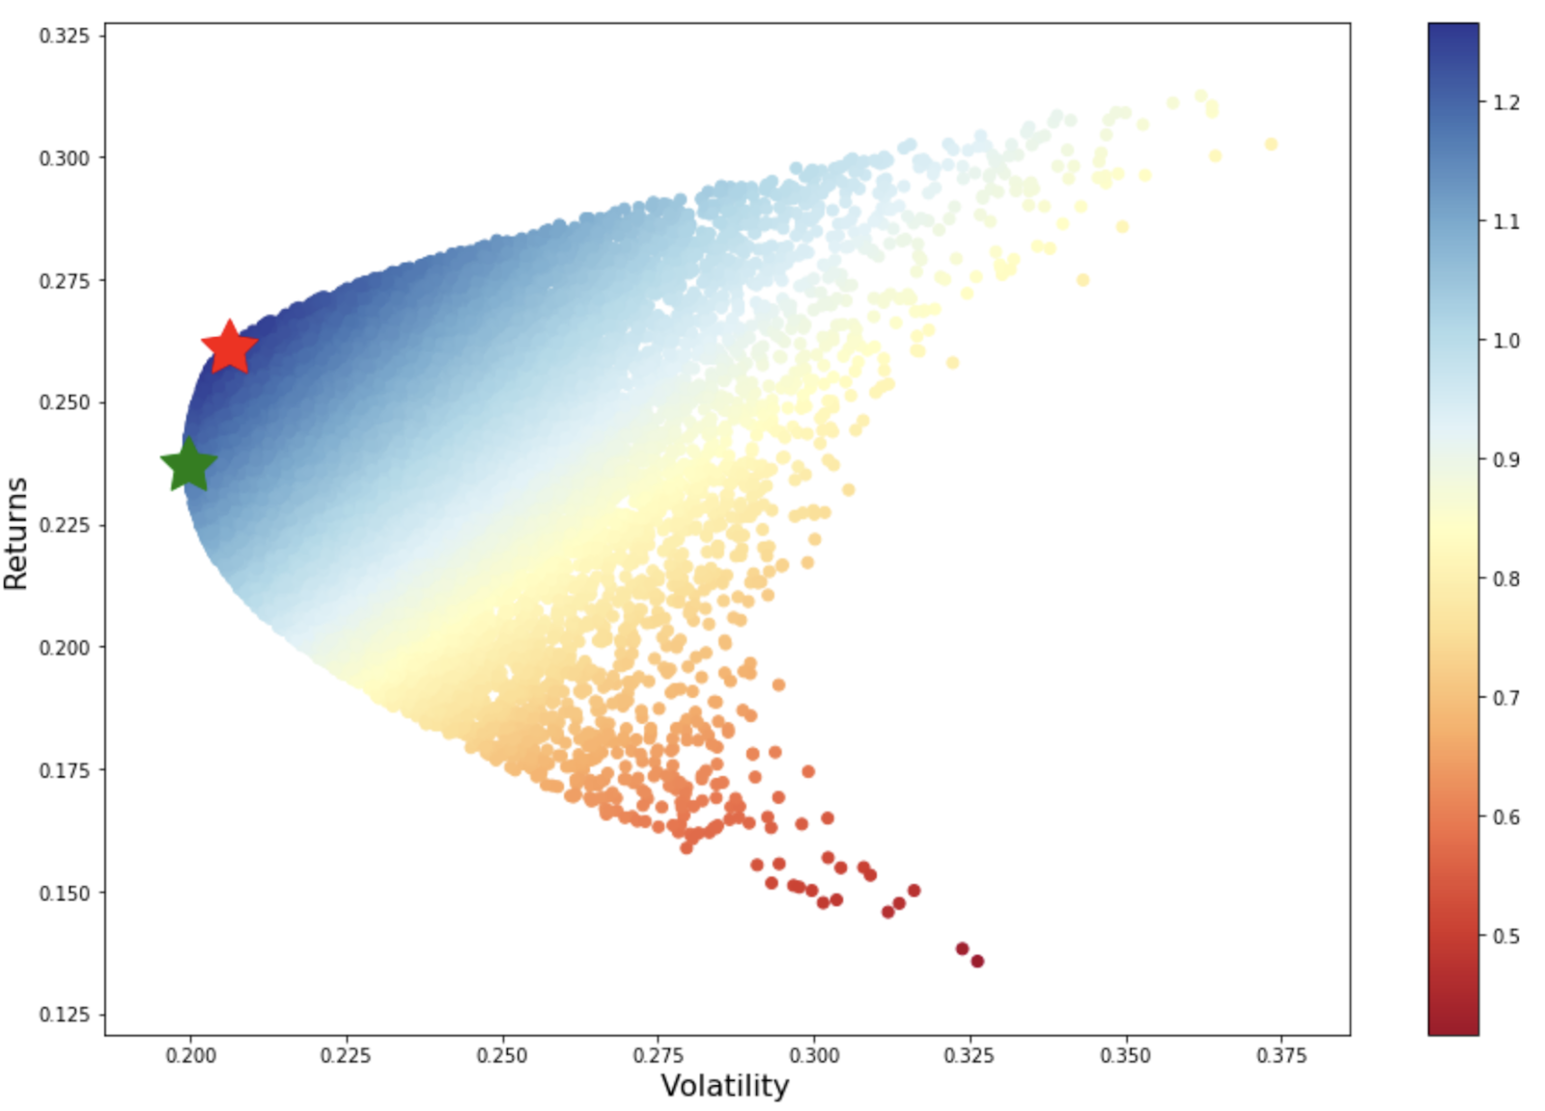
Results
Notes:
The figure on the left shows our efficient frontier. The color scale shows that red portion of the efficient frontier show poor returns-to-volatility ratio closer to 0. The blue portion of the frontier have a healthier returns-to-risk ratio of greater than 1. Therefore, the portfolios that lie below the efficient frontier are sub-optimal because they do not provide enough returns for the level of risk. Portfolios that cluster to the right of the efficient frontier are also sub-optimal because they have a higher level of risk for a level of risk.
Keeping this in mind, we applied a more structured approach to apply the selection of stock weights that would create the optimal portfolio by first finding the highest Sharpe Ratio. This point is shown is the red star. This is the highest risk-adjusted return. So for a level of risk we would undertake, this would result in the highest expected returns.
We also found the lowest volatility portfolio shown as the green star. We find the least risky portfolio and accept the return.
The bar graph to the right shows the asset distribution of these two optimal portfolios. The blue bars represent maximum sharpe ratio and the orange bars represent minimum volatility. As you can see, both portfolios suggest that we invest approximately 40% to Nike and another 40~45% to Starbucks. The difference in the two examples are whether to allocate the majority of the remaining 15% to Bank of America or Nvidia. To achieve the highest risk-adjusted return, the model suggest that we invest more into the gaming company. To achieve the lowest volatility, the model suggest we invest more to Bank of America.

Slide 10
Conclusion & Discussion

Slide 11
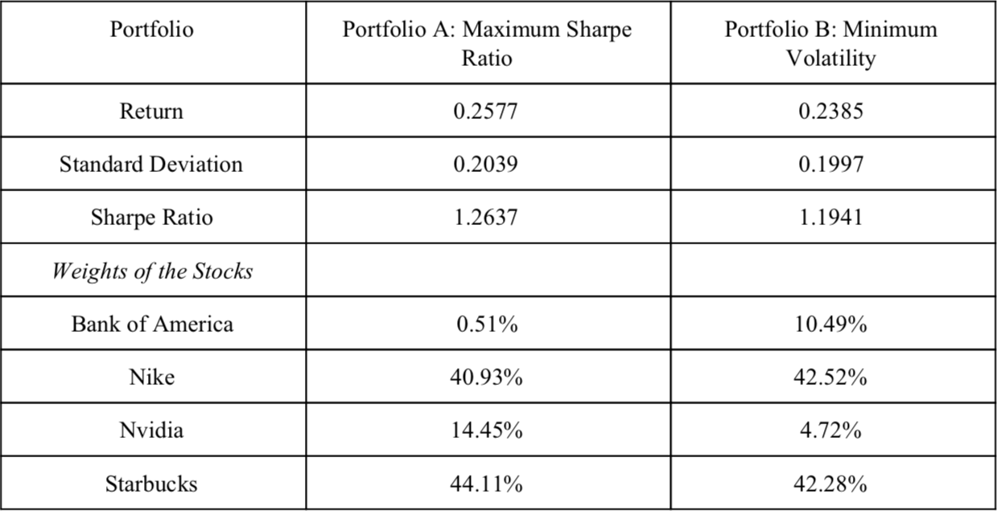
Conclusion & Discussion
Notes:
As for the selection of portfolios, we concluded that no better or correct option exists. The choice of the portfolio - whether to take the higher return or lowest volatility - is subjective based on individual goals and comfort level. If we are more risk-averse, we may opt to investing in the lowest volatility model. If we are seeking to increase our wealth while taking on higher than normal risk, we may opt for the maximum Sharpe Ratio. However, for the purposes of our analysis, we chose the first portfolio since it has a higher Sharpe Ratio and thus indicates that diversification is stronger in this asset mix.

Slide 12
Limitations & Future Work
Good volatility vs. bad volatility
VaR or CVaR?
Notes:
As novice investors, we focused on using the volatility of the overall portfolio as our risk measure for the ease of calculate as did Markowitz. It has generally been accepted that overall volatility (measured in standard deviation) does not differ too much from other specific measures. However, we do recognize that limitations exist in our method since the standard deviation seeks to minimize the overall volatility. In stocks, upward standard deviation is good. This means that we are gaining. For future works, we recommend that a component of Rom and Ferguson’s Post Modern Portfolio Theory (specifically using the downward standard deviation) be used for volatility minimization analysis. We should seek to minimize the losses and not the overall volatility which includes the good volatility (gains) and bad volatility (losses).
In our case, the maximum Sharpe Ratio model suggested we allocate the remaining 15% of Nvidia and the lowest volatility portfolio suggested we allocate the remaining to Bank of America. Having a clear picture of the volatility would have been helpful in deciding which portfolio would yield losses.
In addition, based on our literature review other risk measures exist such as VaR (value-at-risk) and CVaR (Conditional-value-at risk). In addition, our literature review showed that variations of risk measures can be applied such as the VaR and CVaR. VaR factors in a time duration and attempts to evaluate the financial risk of a portfolio during a specific time frame. VaR looks at the worst case scenario during this time. However, CVaR looks at possible losses beyond the VaR and tries to find the average risk of extreme losses beyond VaR’s estimation. Applying VaR or CVaR as the measure of risk could potentially be more meaningful in the interpretation of the actual risk.

Slide 13
The End

